Slide 1
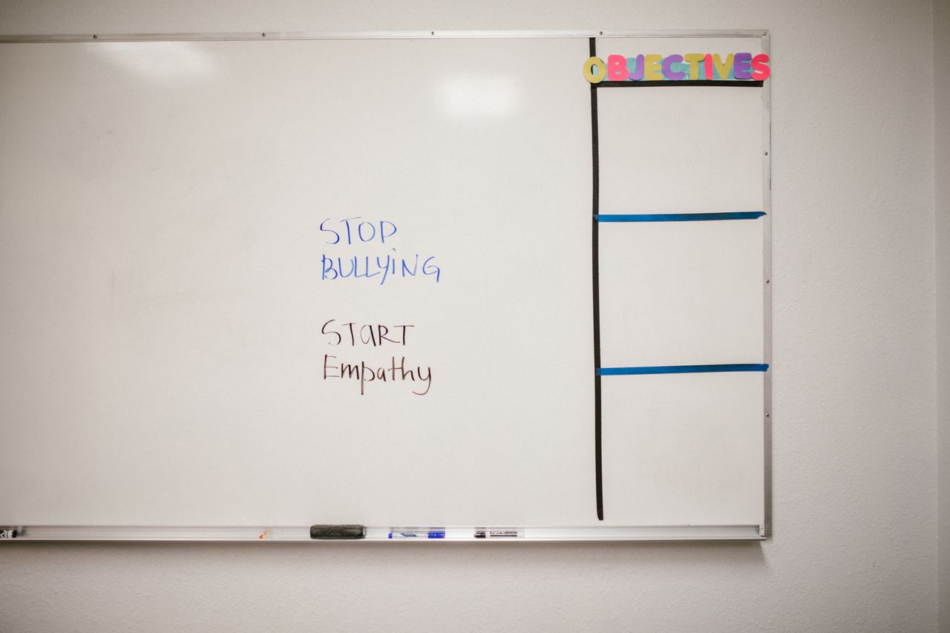
Bullying, Power,
and Bystanders
Grades 10–12
Together For Health

Slide 2
64%
of students who are bullied do not report it — fearing retaliation or being dismissed
Bullying is significantly under-reported, making it harder to address systematically.
Together For Health

Slide 3

📊
The Lasting Impact of Bullying
Victims: 2–9× more likely to consider suicide (Yale study)
PTSD symptoms documented in 40% of severe bullying victims
Decreased academic performance: avg GPA drops 0.5 points per year of bullying
Social anxiety and avoidance can persist into adulthood
Early intervention is critical — untreated bullying creates lasting neural pathways
Together For Health

Slide 4
⚖️
Legal & School Accountability
All Canadian provinces have specific anti-bullying legislation
Schools have a legal duty of care to provide safe environments
Cyberbullying can constitute criminal harassment under Criminal Code s.264
Schools can act on off-campus cyberbullying that disrupts school environment
Document everything: dates, screenshots, witnesses — essential for formal complaints
Together For Health

Slide 5

🏛️
If Formal Intervention Is Needed
Start with the school's safe schools contact (required by law)
1
Escalate to VP/Principal if unresolved — put requests in writing
2
Contact school board if school fails to act adequately
3
Police involvement for: criminal threats, sexual content, extortion
4
Legal aid and human rights complaints available for systemic failures
5
Together For Health

Slide 6
💬
Restorative Approaches Work Better
Restorative justice practices reduce repeat bullying by 40% compared to punitive-only approaches.
The goal is not punishment but changing behavior and repairing harm. Evidence supports this approach.
Together For Health

Slide 7
KEY TAKEAWAYS
Bullying is a systemic issue requiring systemic solutions — not just individual action
✓
Know your rights and the school's legal obligations
✓
Documenting, reporting, and escalating are legitimate and necessary tools
✓
Resources
PREVNet: prevnet.ca/resources
cybertip.ca
Kids Help Phone: 1-800-668-6868
Together For Health

